Slide 1
Maximizing Revenue through Customer Insights
Group C, Team Alpha
E-Commerce Team
Blackwell Industries

Slide 2


OUR OBJECTIVE
Compare client demographics across 4 regions of Blackwell Electronics to investigate and learn from customer purchase behavior.
Make recommendations geared towards expanding our presence in all regions and maximizing revenue generated from e-commerce sales.

Slide 3
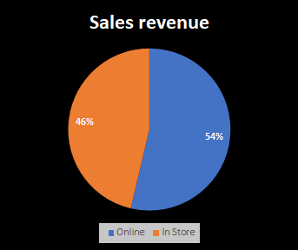
BLACKWELL ELECTRONICS DATA
Using Data Mining Methods, team put together analysis on recent online and in-store sales
Data set provided transaction information by
Age of shopper
Amount spent
50% bought in store and 50% bought online
Region purchased
Number of items
The average transaction was ~$836₁
Overall, Region 4 had the highest amount of spending
Online surpassed in-store
Revenue Highlights
Seeing growth in online presence
Total Sales online $35.89M
Total Sales in-store $30.95M
Data From Blackwell Electronics
Customer age range 18-85
Millennials (18-40)
Generation X (41-60)
Baby Boomers(61-80)
Silent Generation (81+)
Range of items per transaction(1-8)
Amount spent($5-$3000)
Region(1,2,3,4)
In-Store or Online Purchase
Notes:
Seeing growth in our on-line presence
Surpassed by $5M

Slide 4
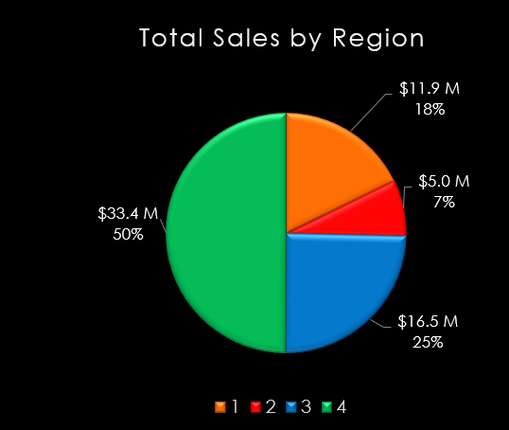
BLACKWELL’S REGIONAL SALES
Insights Gained
Highest revenue generator is Region 4, 50% ($33.4M) with an avg. sales/transaction $1,284
Region 2 provides the biggest opportunity to increase sales 7% ($5M) with an avg. sales/transaction $252
Recommendations
Identify what marketing techniques are being used in Region 4 and apply them throughout
Compare and contrast these company wide result to the online vs. in-store findings

Slide 5
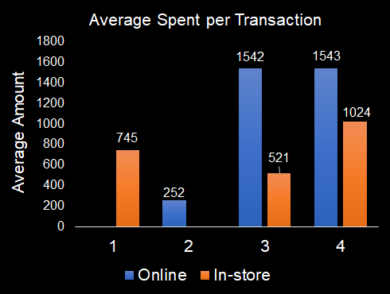
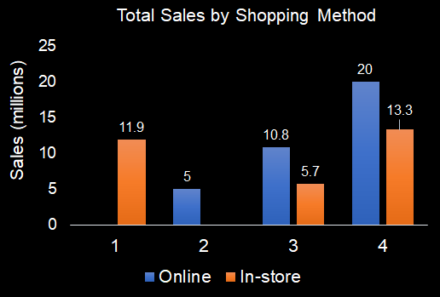
REGIONAL SALES BY SHOPPING METHOD
Insights Gained
Top regions 4 & 3, respectively, spend 1.5 to 3 times more online than in-store
Region 1 buys in-store only
Region 2 buys online only (least online)
Recommendations
Consider online marketing in untapped regions
Target customers strategically on factors that make a difference
Explore age as key demographic

Slide 6
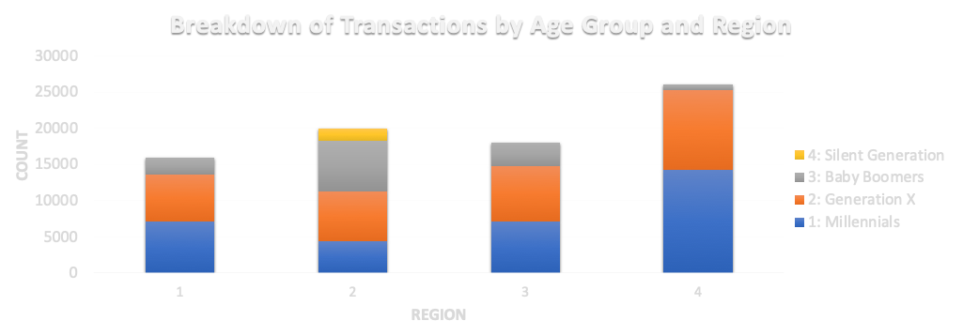
DIFFERENCES IN AGE OF CUSTOMERS BETWEEN REGIONS
Insights Gained
Regions 4 attracts mostly younger customers with the most millennials and Gen X transactions
Region 2 draws in an older demographic, being the only one with Silent Generation shoppers
Recommendations
Consider ramping up direct marketing activities to the untapped millennial market in region 2

Slide 7
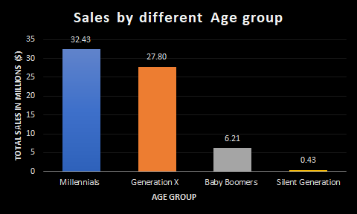
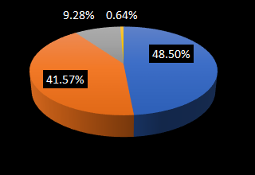
SALES REVENUE BY AGE GROUP
Insights Gained
Millennials (18-40) contribute almost 48.5% ($32.43M) to the total revenue
Generation X (41-60) contributes 41.5% to the total revenue
Baby boomers (61-80) and Silent generation(81+) contribute only 10% to total revenue
Recommendations
Target Baby boomers to increase revenue(Design Changes to website/ Special deals/ focus on Customer service in store)

Slide 8
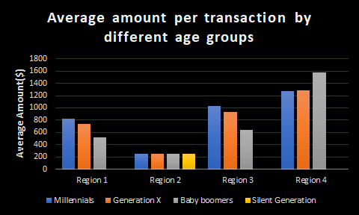
AVERAGE AMOUNT PER TRANSACTION
Insights Gained
Average amount per transaction spent by the same age group differs by region
Customers spend more on an average per transaction in Region-4 followed by Region-3,1 and 2
Baby boomers spend more on an average per transaction than millennials in Region-4
Recommendations
Collect more data to understand why customers in Region-4 spend more and Region-2 spend less.

Slide 9
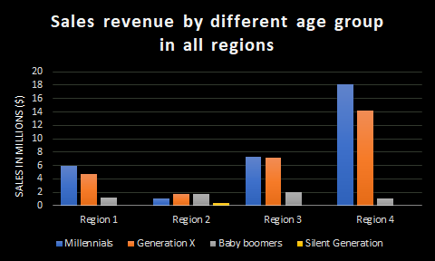
REGIONAL SALES BY AGE GROUPS
Insights Gained
Millennials(18-40) contribute the most to revenue in all the regions, except Region-2.
In Region-4, though baby boomers (above 60) spent more on an average than millennials, their #transactions is less and hence their contribution to total revenue is lesser
Millennials (18-40) in Region-4 alone contribute $18M (27%) of total revenue
Recommendations
Do more marketing in Region 1,2 and target millennials in particular.
Target baby boomers in Region 4.

Slide 10
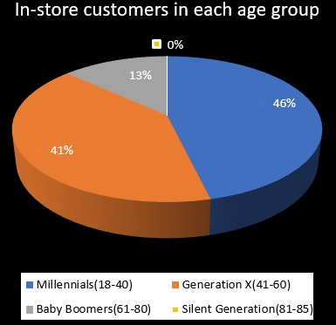
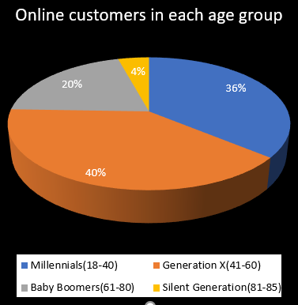
WHO ARE THE CUSTOMERS FOR ONLINE & IN-STORE SHOPPING?
Insights Gained
Age above 60(Baby Boomers & Silent Generation) prefers online shopping comparatively
Millennials are the major contributors for In-store shopping
Total Millennials shopping Online is less comparatively to the Generation X
Recommendations
Analyse why millennials tends to shop In-store
Understand if the millennials have the potential to spend more, if we promote Online shopping to them

Slide 11
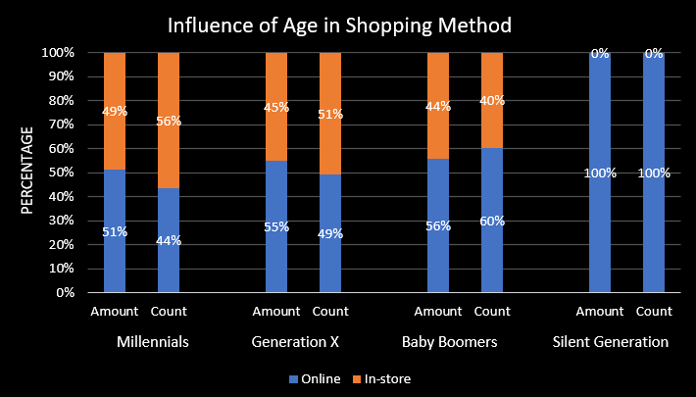
INFLUENCE OF AGE IN SHOPPING METHOD?
Insights Gained
Millennials spend more on online even though the total transactions is less via online
Both Baby Boomers & Silent Generation shoppers tend to shop & spend more online than in-store
Recommendations
Promote online shopping to Millennials
Encourage Baby Boomers to continue the same trend

Slide 12

SUMMARY & KEY OPPORTUNITIES
Region 4 is the most mature market
Regions 1 & 2 present untapped areas of growth
Our youngest customers are our most profitable
Recommendations
Launch awareness campaign in Region 1 to drive current and net-new customers to our online offerings
Conduct cost-benefit analysis of establishing a brick-and-mortar presence in Region 2
Boost ad-presence targeting younger market across Regions 1-3 & Baby Boomers in Region 4 to attract more lucrative customers and maximize revenue potential

Slide 13
UNLOCKING DATA DRIVEN DECISIONS WITH
DATA MINING
What percent of customers are new customers? Will a typical online customers repeat business more or less than a typical in-store customer?
What’s the average income of people in the different regions? Do people in Region 4 make more money than those in Region 2?
What are future sales projections based on historical sales? Will we hit revenue goals?
What products have the customers bought before and regularly purchase? This can help in bundle recommendations and alerting best deals.
Data Mining can untie the hidden pattern about the influence of age in the shopping, which in turn can answer the question what products can attract a particular age group.
Data Mining techniques like Recommender Systems can help companies analyze which competitive items outperform others , and why; valuable in up-sell opportunities, bundling, and future inventory planning.

Slide 14
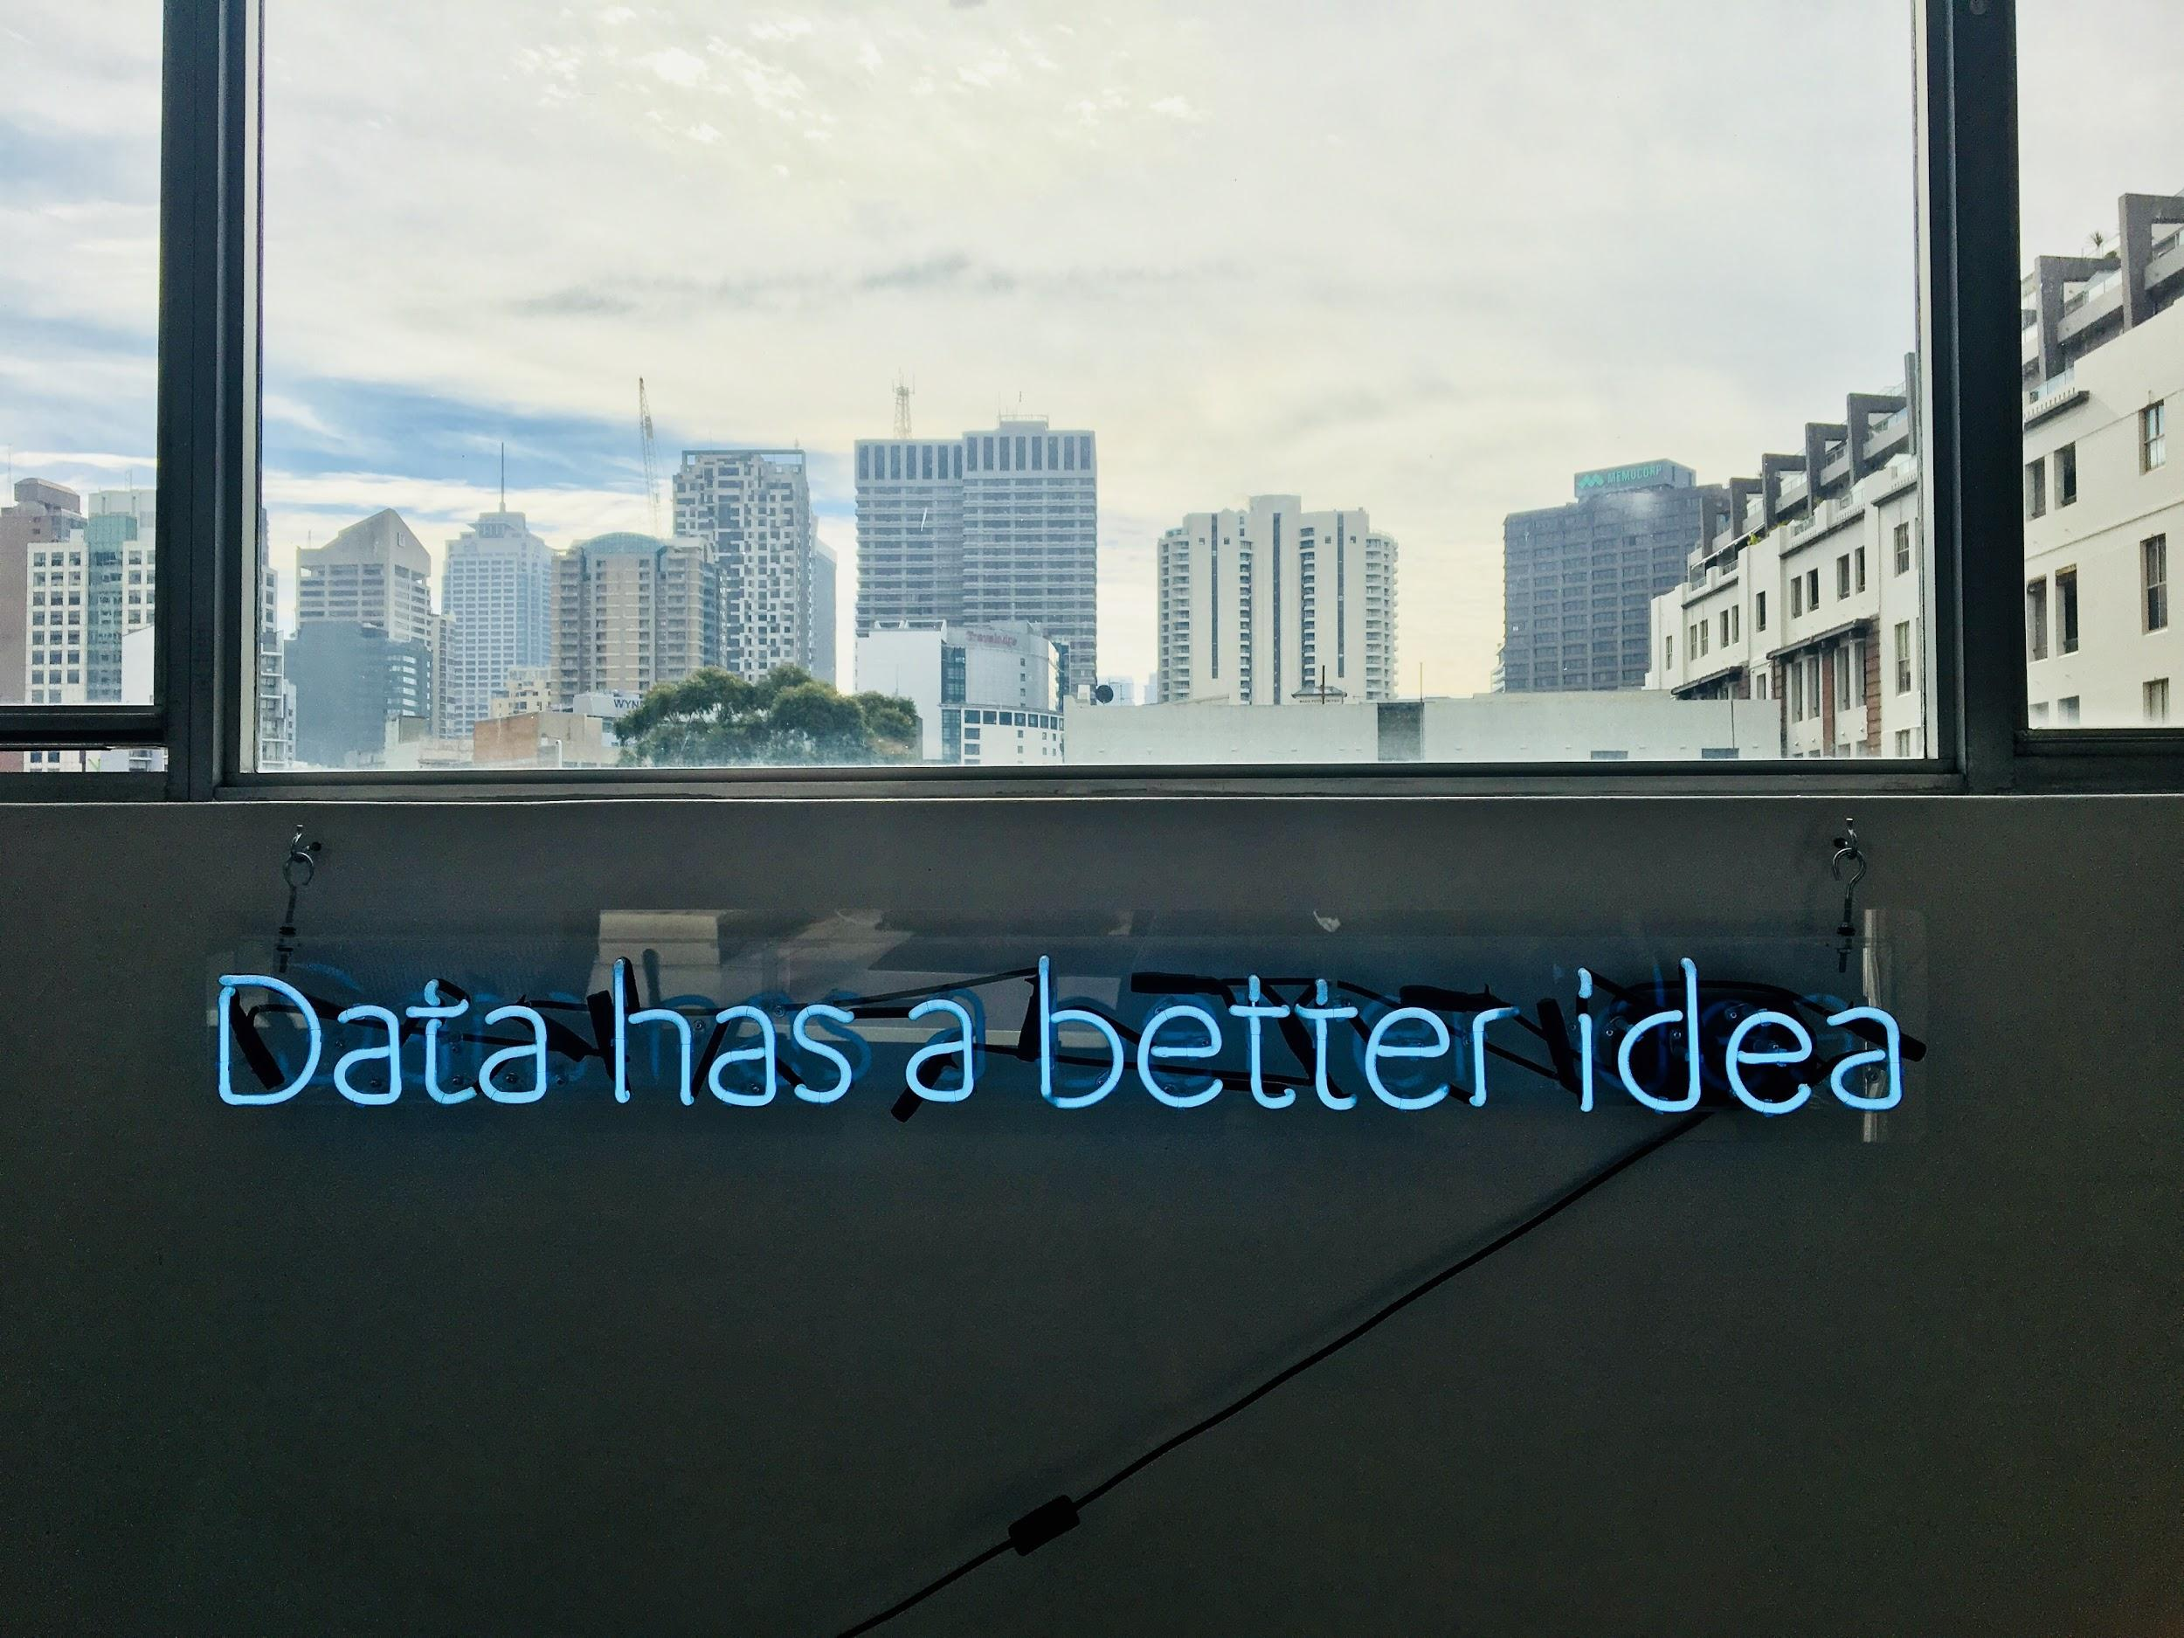
Thank You.

